Slide 1
Film Background Lecture & Discussion
Planet of the Humans
(2020)
For teachers, parents & students
Slideshow:
Are there limits to economic growth?
Are we reaching the planet’s ability to tolerate us?
Provided as open source material for teachers and parents
by political economist John Hardesty, Ph.D.

Slide 2
PLANET OF THE HUMANS (2020, dir. by Jeff Gibbs) is based on three propositions of ecological economics:
(1) Our solitary planet has finite resources and cannot tolerate economic growth forever;
(2) Our profit-seeking capitalist system requires economic growth at both micro and macro levels;
(3) We have made no significant environmental progress to date—and surged past planetary boundaries 40 years ago.

Slide 3

Eco-footprint < or = 1.0
We only have ONE PLANET.
We MUST
learn to live
more simply/humanly
in line with what the
earth provides

Slide 4
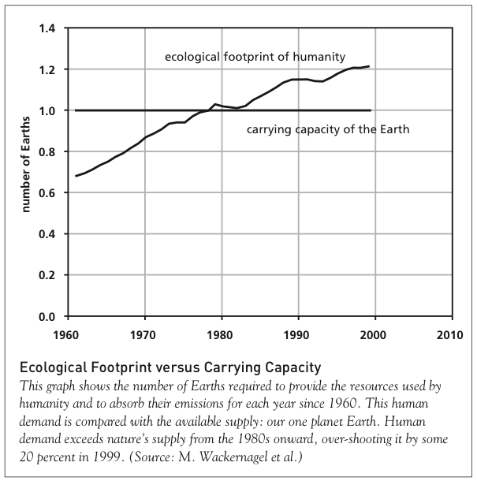
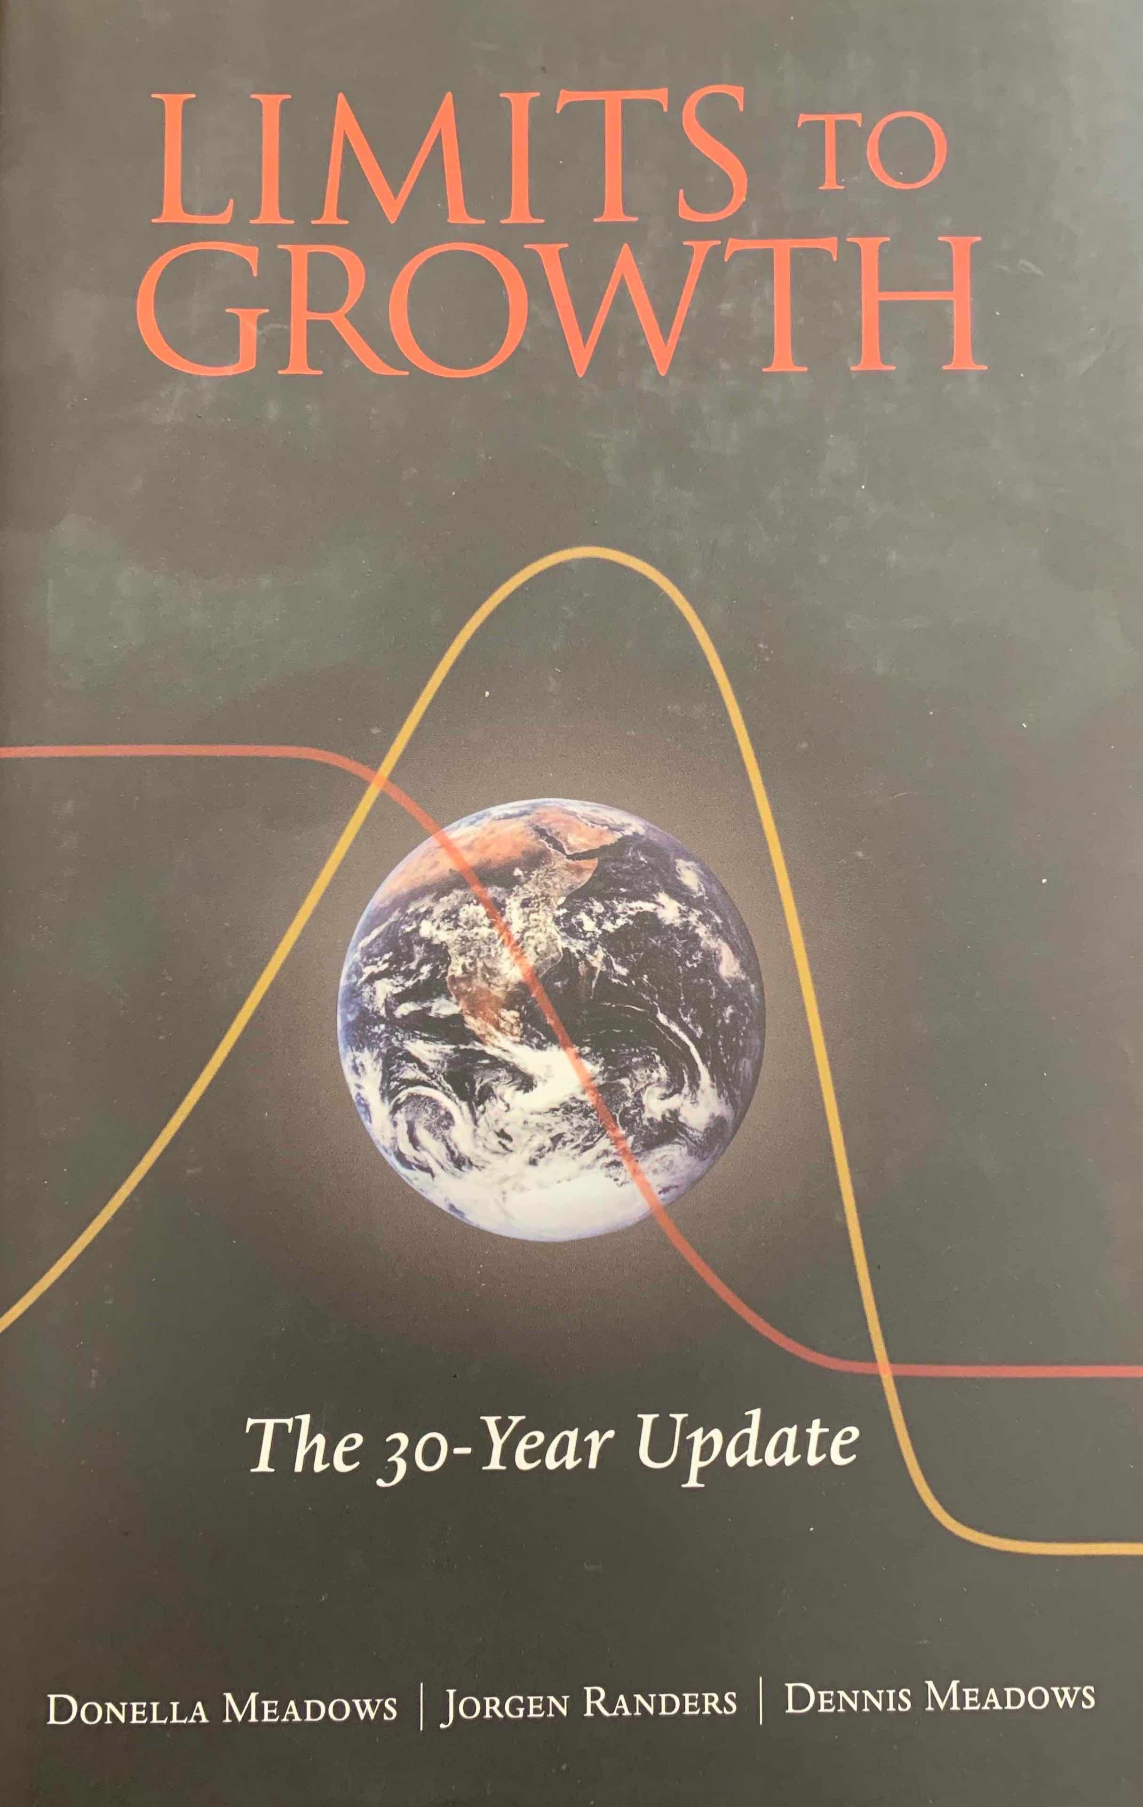
1980: the year we began living dangerously

Slide 5
The Capitalist System
Capitalism is an economic system
Its fundamental institutional basis is private ownership of the means of production and distribution (factories, mines, utilities, retail stores, oil wells, refineries, etc., etc., [referred to as “capital”])
Thus, the essence of capitalism is that some people are owners (capitalist 1%) who control and the remaining 99% work and take orders to survive.

Slide 6
Capitalism is necessarily unequal and hierarchically structured
Capital owners and their top executives (the 1%) have huge incomes and 40% of the wealth.
These incomes come from profits and corporate stock ownership (i.e., they do not have to work)
The 99 percent who must work for a living have far less income and wealth.
Those near the bottom of the income and wealth hierarchy (due to low wages, disability, racism…) then become officially recognized as “the poor,” (e.g., < or = $26,200 family of 4)

Slide 7
Systems have rules and institutional structures
Great majority of U.S. capital (means of production and distribution) is owned by publicly-traded, privately owned corporations
Publicly-traded corporations are owned by shareholders (stockholders) who buy shares on the stock market (e.g., NYSE)
Corporate CEOs, CFOs, and board members have a legal duty to maximize shareholder wealth (stock prices and annual corporate dividends)

Slide 8
On the micro-level, a corporation must:
Maximize shareholder wealth
which is done by:
  reducing product costs (wages/unit)
  and
  Seeking the highest
  market price,
  and
  (3) Increasing product sales

Slide 9
This is achieved by profit-maximization
The private firm that fails to maximize profits by reducing costs and selling more goods loses out in market competition to firms that succeed.
Then a large portion of profits made in one year must be sunk back into
expanding the business so that
more goods can be sold next year.

Slide 10
On the macro-level, a capitalist economy that fails to grow experiences job loss and unemployment
These are called “recessions” or “depressions.”
In 2020 the covid-19 pandemic is causing a recession worldwide expected to be worse than the 2008-2009 “Great Recession.”
But while this is very bad for people, it is very good for the planet: pollution and carbon emissions are down.

Slide 11

Hypothetical from the documentary
Roger and Me
(dir. by Michael Moore, 1989)
Roger Smith,
CEO of General Motors
1981-1990
Understands the company can make greater profits by moving Flint, MI assembly plants to Mexico where wages and environmental regulations are lower
BUT refuses to move because of the harm it would do to the tens of thousands of Flint employees and to city of Flint, MI

Slide 12
What happens then?
1. Legally: Smith is personally liable to a shareholders’ lawsuit for failing to maximize shareholder wealth
2. Economically: GM will lose ground (market share) to other car corporations that do move their plants to low wage countries and can sell cars at lower prices than GM
Meaning:
Capitalism is NOT a group of individual men & women who do good or bad things but a system of institutions with rules, regulations, and requirements

Slide 13
Since the Great Depression
For the past 88 years, the federal government has realized its responsibility to keep the economy growing at any cost.
Without government intervention economic crises would be frequent and devastating.
Thus, both economic and political requirements dictate unquestioned and perpetual economic growth under capitalism.

Slide 14
The Coronavirus Lessons
The vast human global economy has been laid low by a tiny simple “creature.”
There are no technical fixes, because there are millions of viral strains, many of which are likely to be deadly to humans.
As the global economy dialed back, nature responded.

Slide 15
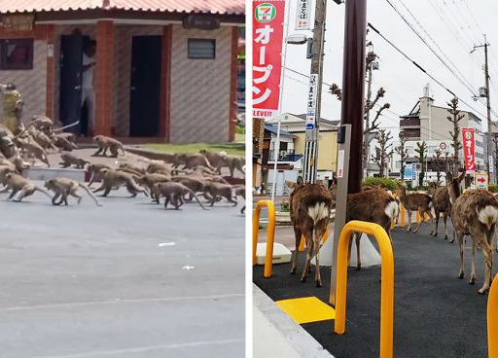

Slide 16
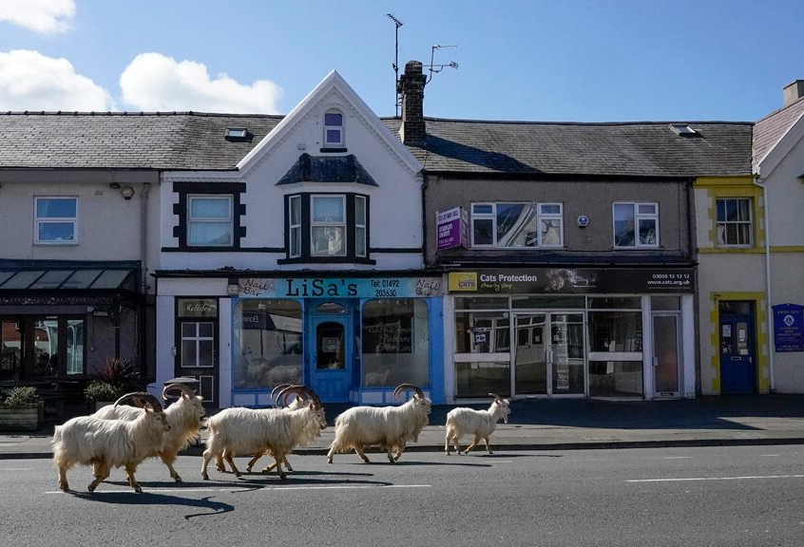

Slide 17
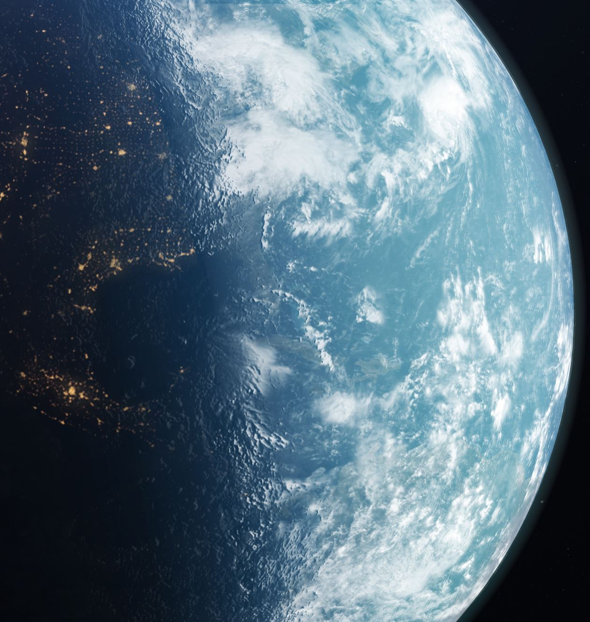
This pandemic and most other new, dangerous viruses
Are caused by human economic expansion that brings close contact with (1) wild animals or (2) factory chicken, duck, pig or cattle farms
And are spread rapidly throughout the human world by global economic activity (air travel, global shipping…)

Slide 18
Human economic expansion also causes:
Climate change/crisis (by emitting CO2, methane, etc.)
Declining ocean viability
Mass extinction of non-human species

Slide 19
A key way to sum up this point is
By using human Ecological Footprint analysis
This is a scientific measure of the earth’s ecological resources used by humans
1980: 1.0 planets
2019: 1.75 planets
That means we are far past what this earth can provide, and
we would have to have another earth-like planet in order to live sustainably,
And, even with a second planet, we would still have to STOP growing economically!

Slide 20
The Awful Truth
Begin with a global ecological footprint = 1.75
To reduce that to 1.0
Means (approx.) -43% global GDP*
i.e., negative growth!!! (aka “degrowth”)
During the 2020 pandemic we DO have negative economic growth.
But under capitalism humans suffer
And the poor and oppressed suffer most
Both within and between nations
*Note: an approximate, suggestive number

Slide 21
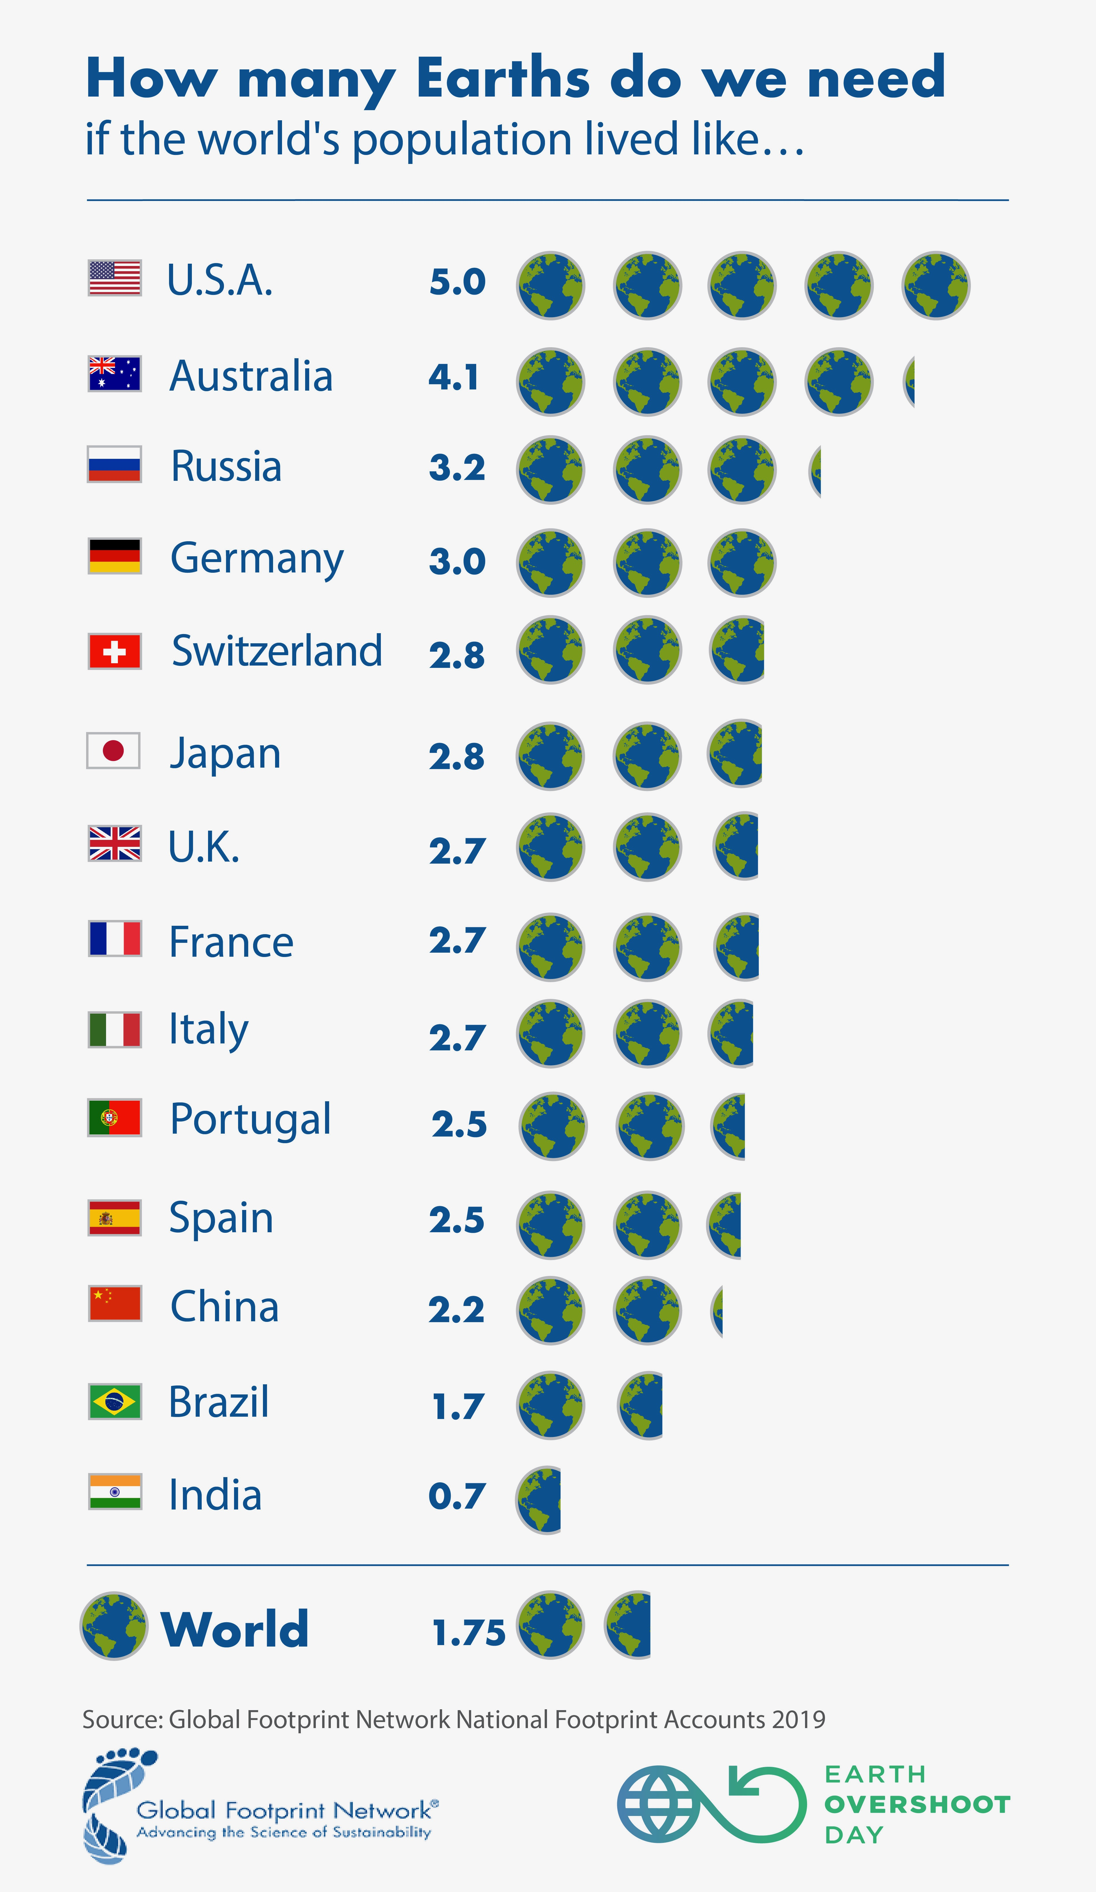
The global impact of nations
(eco-footprint) varies dramatically

Slide 22
A Stable and Sustainable World Requires Massive Sharing of Resources
Assume GWP (Gross World Product) = $100 trillion
To live at 1.0 planets → GWP = $57 trillion
But what about poor countries in Africa, Asia, Latin America?
For example, Burundi has per capita GDP = $744 (compare USA = $60,000+)
Can we ask poor countries to cut their per capita GDP by 43%? Or, at all?
What is REQUIRED?
Can RICH COUNTRIES move from exploitation to sharing?
Must THOSE wealthy nations reduce beyond 43%?

Slide 23

This is a process called degrowth that…
Aims to re-politicize environmentalism by “ecologizing society” and discarding
“green growth” notions
Rejects all energy systems based on increasingly sophisticated technological organizations managed by bureaucrats and technocrats
Not just because they pollute
But they become decreasingly democratic and egalitarian over time
And this includes not only fossil fuels but nuclear, big hydro, big wind, concentrated solar, etc.

Slide 24
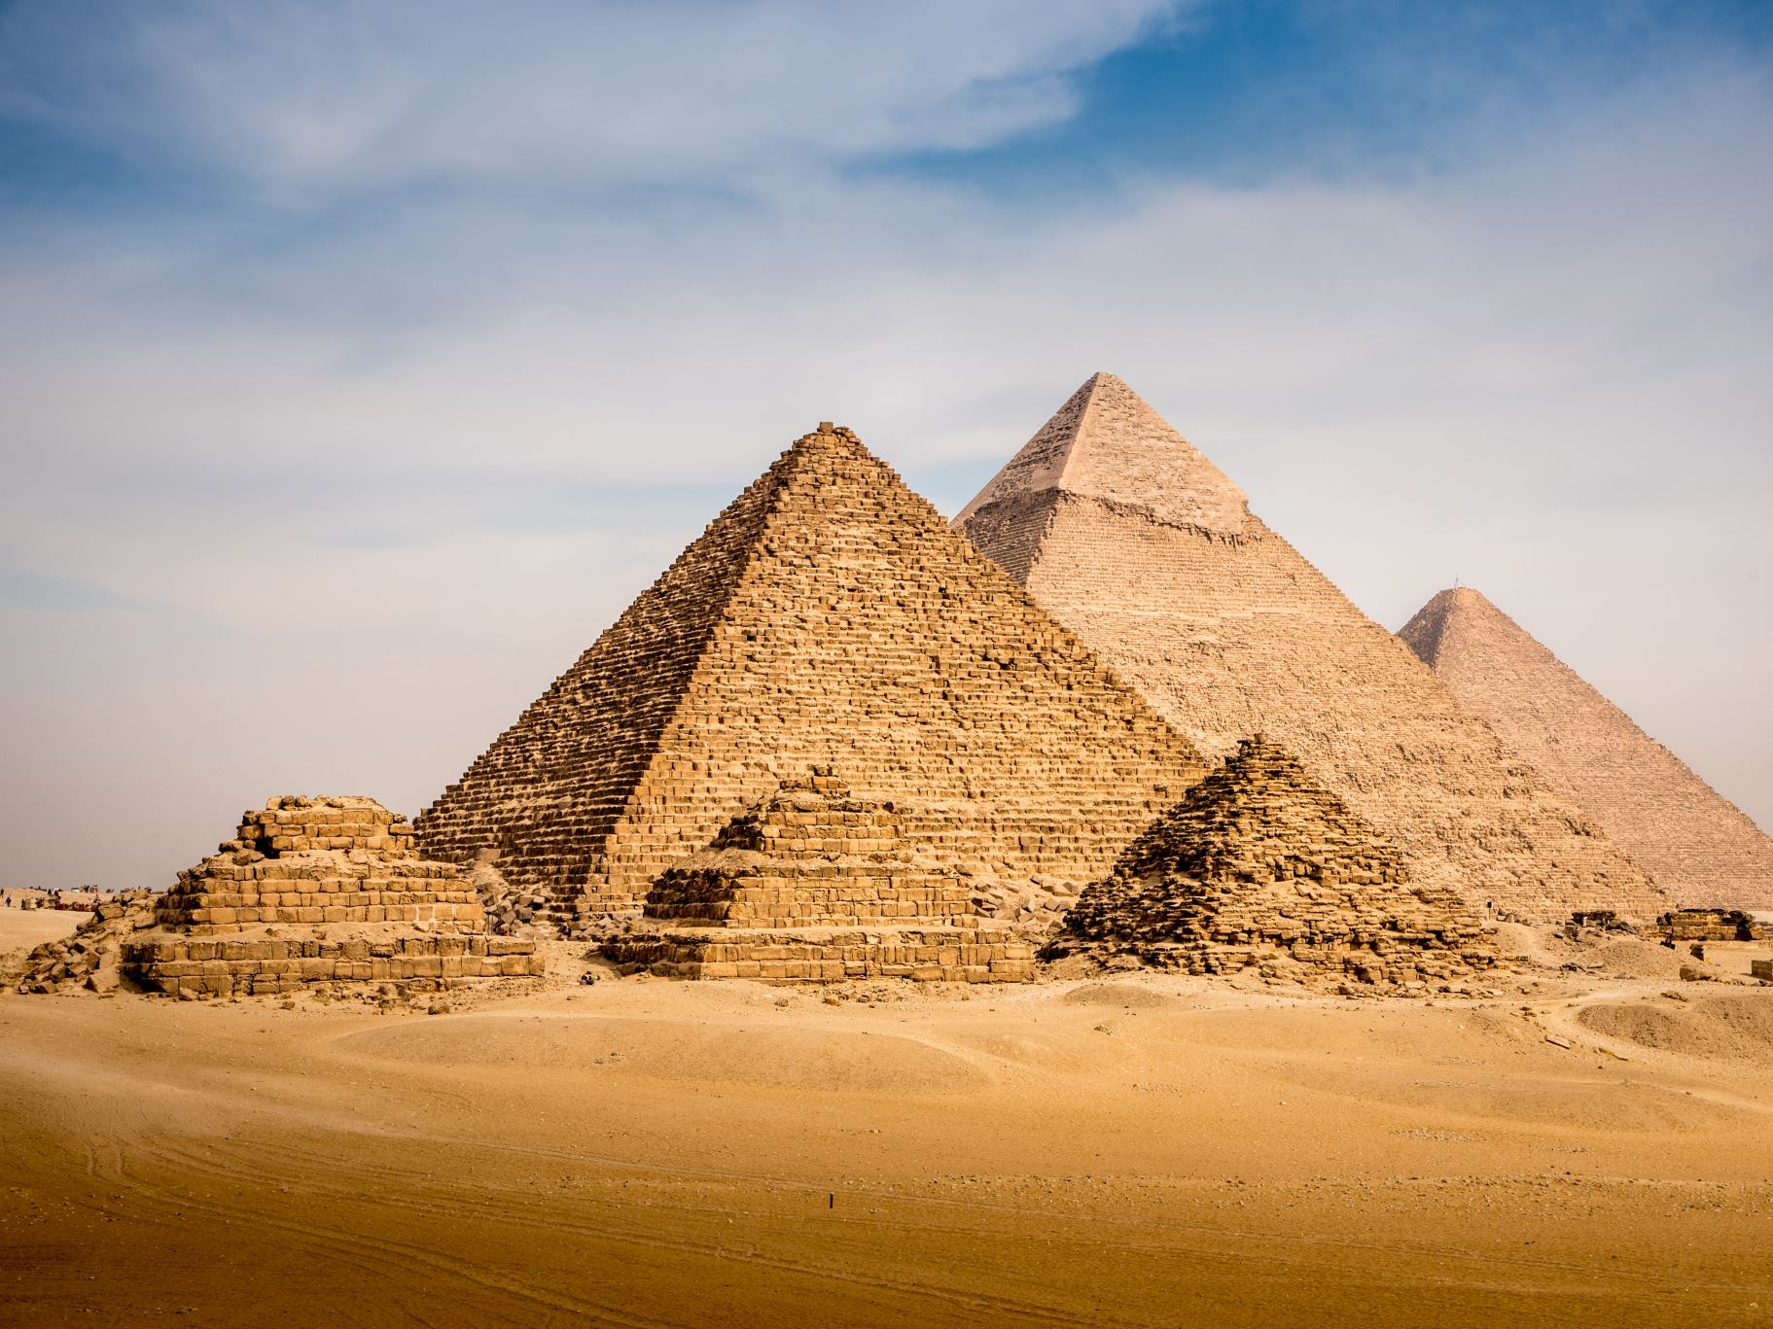
Degrowth...
Evaluates the economy in terms of how it uses its economic surplus
Ancient Egypt built the pyramids.
Feudal Europe built the cathedrals (and crusades).
Modern capitalism builds more unnecessary economic growth
(and militaries).

Slide 25
Degrowth…
Advocates not only “using” the economic surplus to downsize
Caring
Sharing
More labor-intensity of work
Cooperation (worker control, consumer control)
but, importantly, to reorganize society to emphasize:

Slide 26

These features could mean—under the slogan
“Redistribution not Growth”— such changes as, for example:
Local food growing
Urban gardens
Housing cooperatives
housing for all
Communal kitchens—
food for all
Communal clinics--health care for all
Decentralized renewable energy
Shorter workweeks
Job guarantees
Guaranteed basic income for all

Slide 27
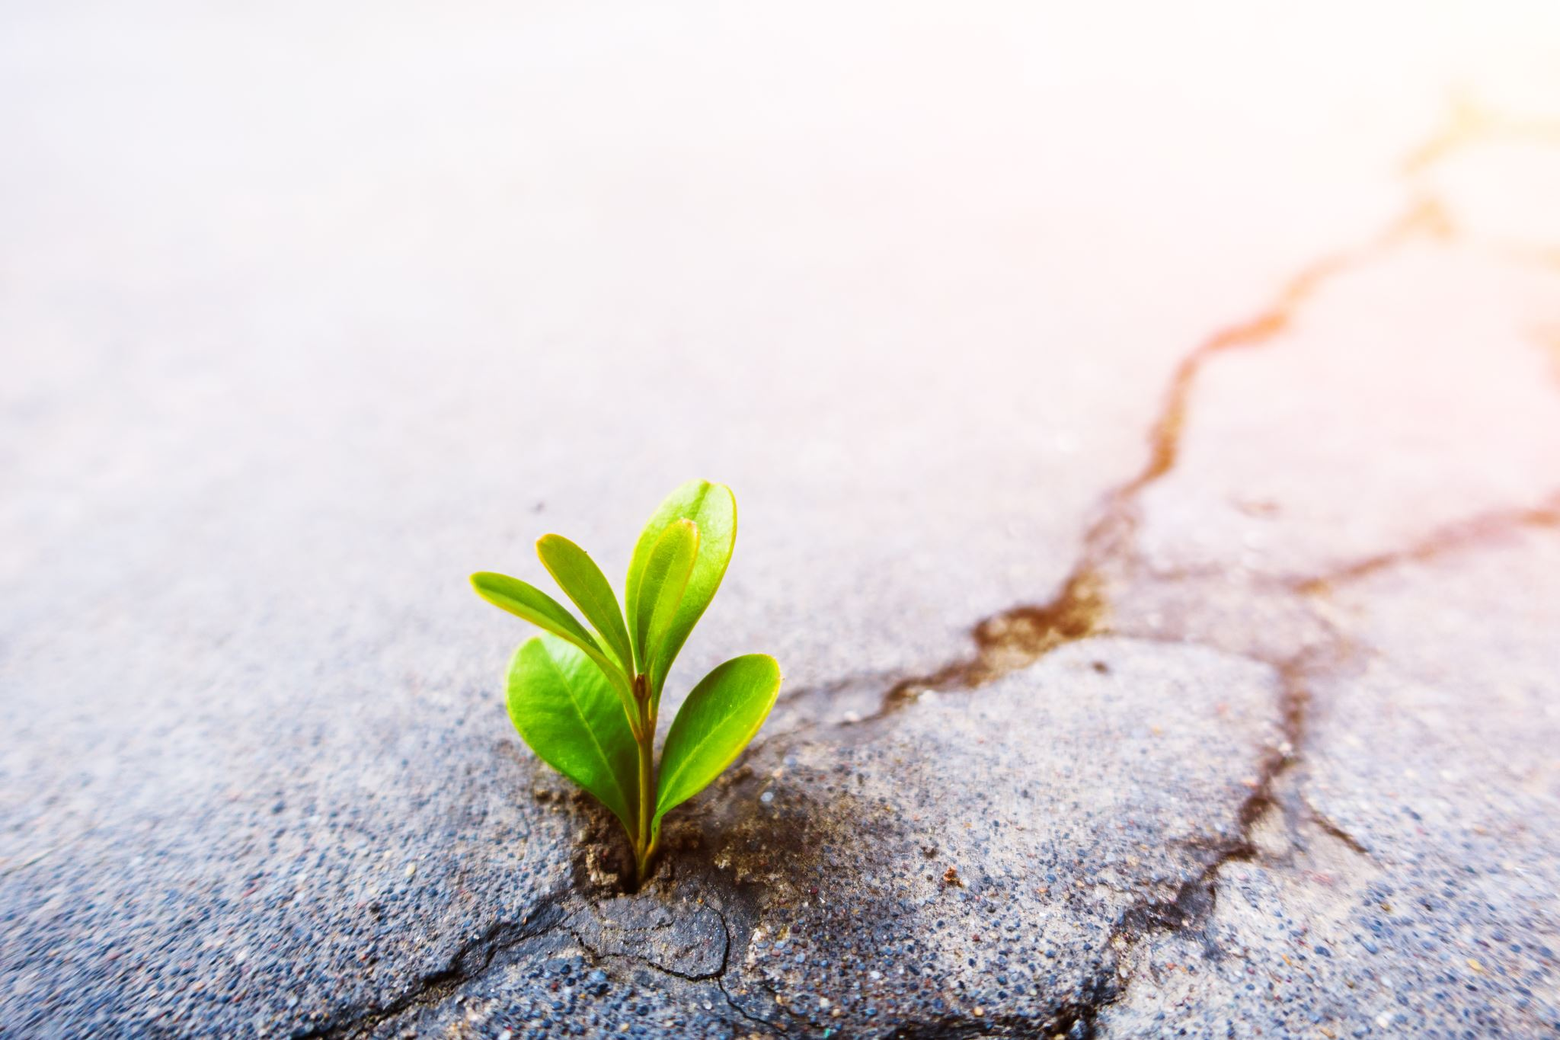
These new ways of life could be implemented as
a process of adaptation to the stagnation of the economy
as it fights against planetary boundaries.
If, that is, people fight back
and
refuse to return to the deadly “normal”
that got us here.

Slide 28
“Degrowth” necessarily means
Transitioning away from a capitalist economic system that requires growth
And, transitioning toward a localized, democratic socialism
By, for, and of the people

Slide 29
How would democratic socialism differ?
NO corporate class inequality and power
NO wealthy shareholders to be fed and obeyed
NO capitalist ruling class/deep state/power elite
NO corporate profit maximization requirement
Which means we could stop endless GDP growth
And provide meaningful sustainable work, incomes, homes, health care for all

Slide 30
In terms of avoiding climate catastrophe, one study calculates:
Every person in the world must limit their CO2 emissions to 2.7 tons per year from now to 2050 in order to keep the
global temperature rise
under 2 deg. C.

Slide 31
Dale Jamieson, Reason in a Dark Time (2014)
[Prof. Environmental Studies & Philosophy, NYU]
An individual exhausts 2.7 tons
of CO2:
by one round-trip flight SF to NYC,
OR
(b) by maintaining a typical single-family American home for one month
OR
(c) by six months (average) driving in USA
Jamieson concludes: by this standard virtually all Americans are human rights violators.
(As are most of people in the rest of the world who live similar lifestyles.)

Slide 32
Do you feel like a human rights violator?
ASK:
Working people did not create the mass consumer lifestyle/system
Who destroyed the U.S. streetcar system and got us hooked on the internal combustion engine?
Who created the suburbanization of America?
Who advertised this lifestyle globally?
Who destroyed all the movements for alternative ways of living like democratic socialism?

Slide 33
We had some sustainable ways of living that capitalism destroyed
Grazing farm animals
Family farms
Streetcars
cable cars

Slide 34
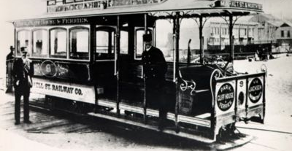
Brand new cable car No. 9 awaits another trip from Bay and Taylor Streets to Powell and Market. The cables used for this trip would be powered by steam power.
SF 1873, 26 lines

Slide 35
Critique of the claim
“we are all human rights violators”
What is missing
in this discussion?
The consideration of who has the power in our country and who does not
The controlling role of the capitalist system
The systems of politics and economics that developed historically and took us to this place

Slide 36
Discussion
(or essay prompts)
IF the only way “civilization” or, worse, even our species, makes it much past year 2100 is if we learn to share planetary resources more or less equally…
What would you immediately focus on as a citizen to start this process of change?
Explain.
Explain what you think must come first, political or economic change.

Slide 37
Discuss
What would you tell the
U.S. president elect to do
in his first 100 days
in office in 2021?

Slide 38
Discuss
If economic surplus is the “extra” production above what it takes to provide for the basic needs of all the people, name three categories of our surplus you would reduce/eliminate first (e.g., advertising?).
  Why start with these categories?

Slide 39
Discuss
  Is it the responsibility of the individual to change their habits and way of life, or is it the responsibility of society? Explain.
  For societal-level change to occur, what works best?
  Top-down forces (like through electoral politics
  and getting the right person in office)?
  Bottom-up forces like grassroots organizing
  (protests, direct actions, etc.)?
  Some combination?

Slide 40
Discuss
In terms of sharing resources with the world’s less privileged,
how and where do we (in particular, wealthier countries like the United States) start?
Is there anything we should stop doing internationally? Anything we should start do internationally?

Slide 41
Discuss
How can we make life within wealthier countries like the United States more equitable?
What programs do we need?
What should we stop doing?

Slide 42
Discuss
Brainstorm a list (then discuss) 5-10 things
  most people accept unquestioningly
  that would have to change drastically
  to live with an ecological footprint of < 1.0 planet.

Slide 43
Discuss
What will our nation be like--
What will our world be like--
If we are able to achieve an ecological footprint < or = 1.0?
Because, there is
ONLY ONE EARTH

Slide 44
Concluding comment
So, as Michelle Alexander and others have said,
It is
“All of Us or None.”
If economic growth is killing our planet, then don’t we need to
  JUST STOP IT
  and
  (2) share the earth’s resources equitably?

Slide 45
References
“Planet of the Humans (2020) Film Discussion Guide”
open-source material (free to download) for teachers and
students, provided by Rumble Media. Watch film HERE.
Books
Harrison Brown, The Challenge of Man’s Future (1954)
Barry Commoner, The Closing Circle (1971)
Herman Daly, Steady-State Economics (1977)
Charles A.S. Hall & Kent Klitgaard, Energy and the Wealth of Nations (2nd. ed. 2018)
Richard Heinberg, Peak Everything: Waking up to the Century of Declines (2007)
Richard Heinberg, The End of Growth (2011)
Warren Johnson & John Hardesty, Economic Growth vs. the Environment (1971)
Giorgos Kallis, In Defense of Degrowth (2017)
Donella H. Meadows, Dennis L. Meadows, Jorgen Randers, & William W. Behrens III, The Limits to Growth (1972)
Donnella H. Meadows, Dennis L. Meadows, & Jorgen Randers, Beyond the Limits: Confronting Global Collapse, Envisioning a Sustainable Future (1992)
Donella Meadows, Jorgen Randers, and Dennis Meadows, Limits to Growth: The 30-Year Update (2004)
E.F. Schumacher, Small is Beautiful: Economics as if People Mattered (1973)
Articles
Philip Alston, United Nations Special Rapporteur, “Report of the Special Rapporteur on extreme poverty and human rights on his mission to the United States” (June 2018) and “Statement on Visit to the USA by Professor Philip Alston UN Special Rapporteur on extreme poverty and human rights” (Dec. 15, 2017)
Kenneth Boulding, “The Economics of the Coming Spaceship Earth, in Environmental Quality in a Growing Economy (Henry Jarrett (ed.) 1966)
“This essay with its vivid metaphors of the cowboy and spaceman economies, can be credited with energizing the field of environmental economics in the late 1960s. Boulding described the open economy of the past with its seemingly unlimited resources and contrasted it with the closed economy of the future. He wrote, ‘I am tempted to call the open economy the "cowboy economy," the cowboy being symbolic of the illimitable plains and also associated with reckless, exploitative, romantic, and violent behavior, which is characteristic of open societies. The closed economy of the future might similarly be called the "spaceman" economy, in which the earth has become a single spaceship, without unlimited reservoirs of anything, either for extraction or for pollution, and in which, therefore, man must find his place in a cyclical ecological system which is capable of continuous reproduction of material form even though it cannot escape having inputs of energy’ (Boulding 1966: 9).”
John Hardesty, Norris, C. Clement, & Clinton E. Jencks, “The Political Economy of Environmental Destruction,” Review of Radical Political Economics (1971)
Giorgos Kallis, “In Defense of Degrowth,” Ecological Economics (2011)
Giorgos Kallis, “Socialism Without Growth,” Capitalism, Nature, Socialism (2019)

